Slide 1
CSE 12 – Basic Data Structures and Object-Oriented Design Lecture 1
Greg Miranda & Paul Cao, Winter 2021
This lecture is being recorded

Slide 2
Fair Notice of Class Recording Announcement
Each class online lecture for CSE 12, including this one, will be recorded and made available to students asynchronously.

Slide 3
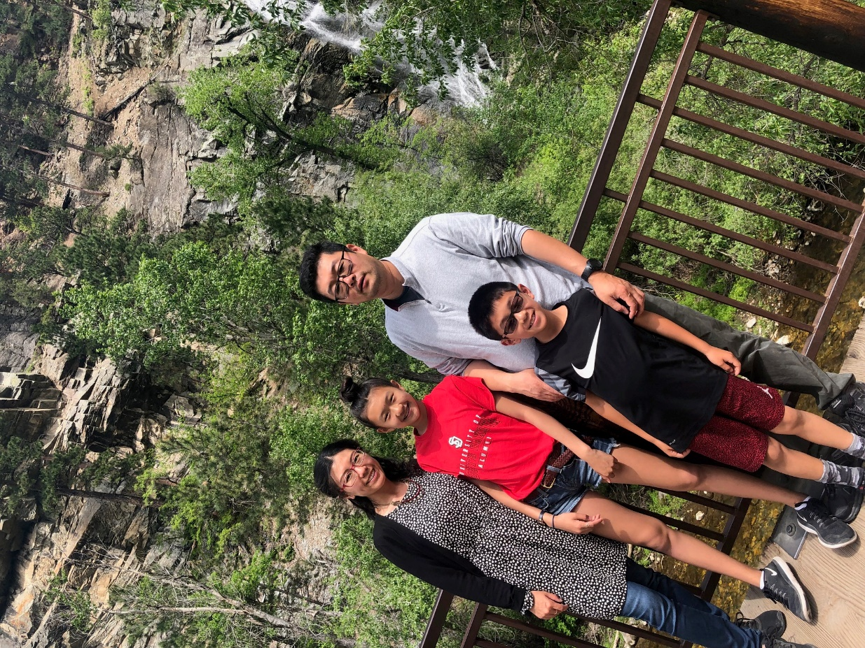
Paul Cao
Started at UCSD in Fall 2015
Taught at liberal arts colleges before moving to SD
Research area in CS Education
Teaching Background:
Nearly all lower division courses
8A/8B/12/30/100/95
When I’m not working:
Be a good grocery shopper for the family
DIY stuff

Slide 4
Technology and responsible class conduct
Please be considerate with your use of technology
Use technology for purposes directly related to the course only
NO MULTITASKING!
Sign off of Facebook/Instagram/snapchat/Slack/messenger
Close all games
Don't open other URLs

Slide 5
Announcements
Discussion starts in week 1
Syllabus and canvas information
https://ucsd-cse12-w21.github.io/

Slide 6
Java Review
Let’s vote on the worksheet problems

